Slide 1
Facial Animation And Skinning
Dinghuang Ji

Slide 2
Outline
Definition of the Problem
History Highlights
Interested Topics
Data driven facial animation
Mesh deformation
Physical based facial animation

Slide 3
Definition of the Problem
(Computer) facial animation is primarily an area of computer graphics that encapsulates models and techniques for generating and animating images of the human head and face[7].
There are some related topics that I will not cover. 3D Face modelling requires knowledge of anthropometry and assistance of range scanner or structured light [14][15]. Skin and hair rendering could enhance animation effects[16][17]. Performance driven facial animation supplies intuitive interface[18][19].

Slide 4
Definition of the Problem
This is a well deﬁned problem, but it is difﬁcult to solve.
We are intimately aware of how human faces should look and sensitive to subtleties in the form and motion.
Face expression and head movement work together to convey meaning.
Expressions are further affected by the emotions.
Facial anatomy is both structurally and physically complex: there are many layers of different kinds of material (skin, fat, muscle, bones).

Slide 5
Milestones
In 1970’s, Parke, F. I. build the first 3D parametric facial model enable generate specific facial animation with few parameters. For example, rotation of the jaw or direction of eye gaze[2].
In 1970’s, Paul Ekman et. Al. made a standard to encode movements of individual facial muscles.[4]
In the 1980’s, Keith Waters developed a muscle based facial model with physically based skin tissue.[5]

Slide 6
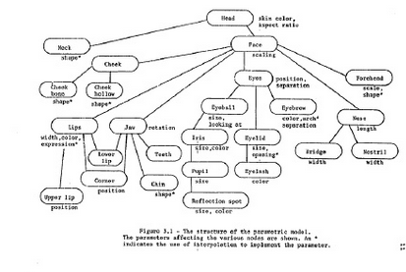
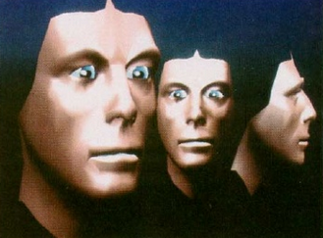
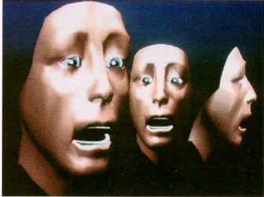
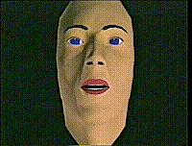
Parke’s Facial Model
Water’s Facial Model
“Tony de Peltrie” (1985) marked the first time computer facial animation played an important role in telling a story
The Pixar short “Tin Toy” (1988) was the first computer-animated film to win an Oscar. The childʼs face is animated using a Waters-style model.

Slide 7
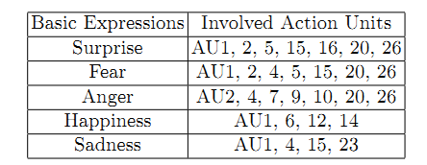
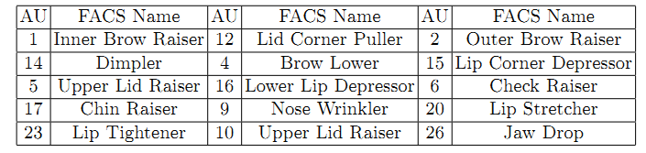
Facial Action Coding System[4]
FACS is a description of the movements of the facial muscles and jaw/tongue derived from an analysis of facial anatomy, which includes forty four basic action units.
Combinations of independent action units generate facial expressions

Slide 8
Facial Action Coding System
For its simplicity, FACS is widely utilized with muscle or simulated muscle based approaches.
Limitations:
AUs are purely local patterns while actual facial motion is rarely completely localized
FACS oﬀers spatial motion descriptions but not temporal components.

Slide 9
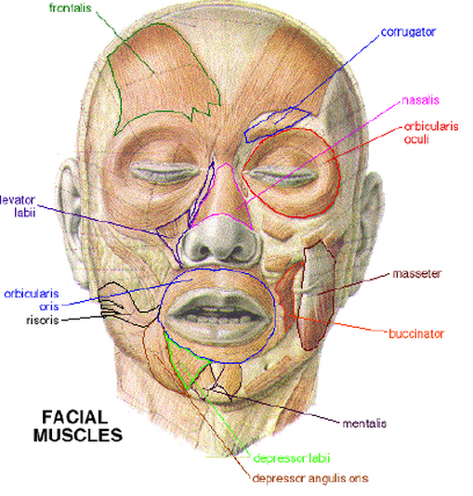
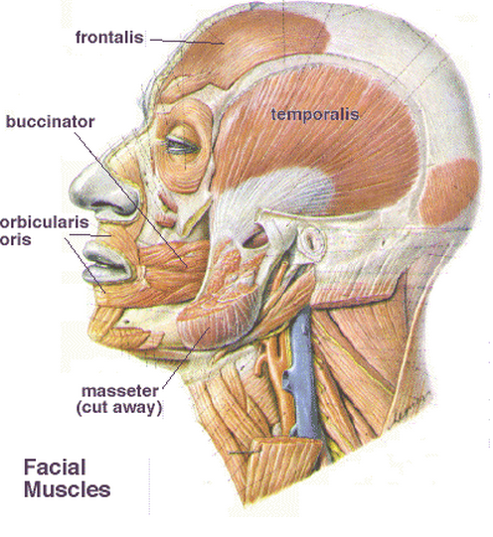
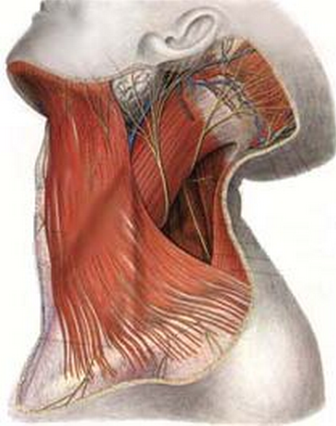
Muscles of the Face

Slide 10
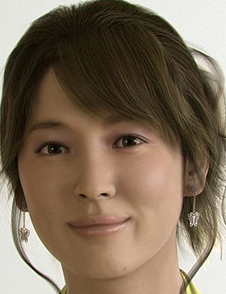
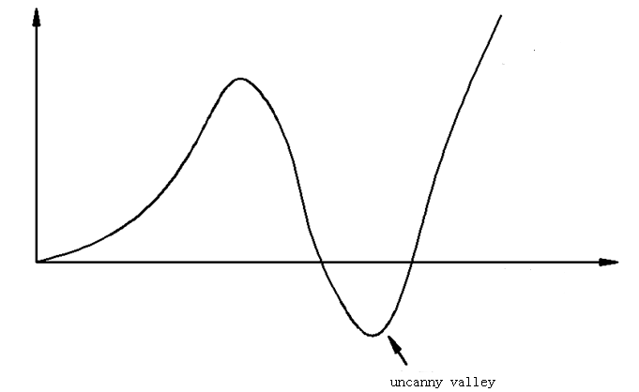
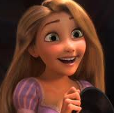
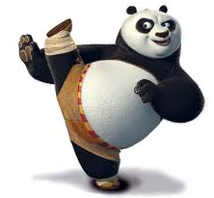
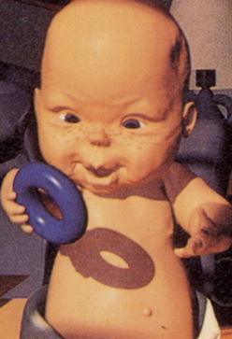
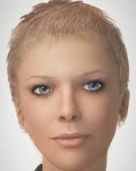
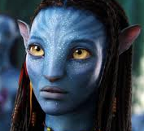
Uncanny Valley
Familiarity
Real Person
Similarity

Slide 11
Interested Topics
Data Driven | Linear Blend shape | Non-Linear Blend shape | Temporal-spatial analysis | Interface design
Mesh Deformation | FFD | 3D Morphing | Expression Cloning | Deformation Gradient
Physical modelling | Spring-Mass | Vector Muscle | Vibration model | Skin fabrication

Slide 12
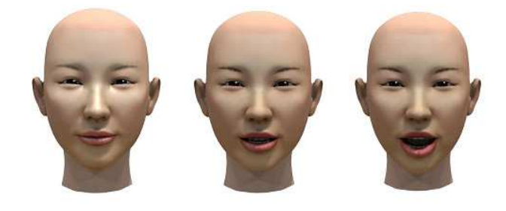
What’s blend shape?
Blend shape is a set of geometrical models :
With vertices correspondence
With same topology
Blend shape Interpolation
The weights wk are manipulated by the animator in the form of sliders (with one slider for each weight) or automatically determined by algorithms. vj is the position of j^{th} vertex and Bkj is the positon of j^{th} vertex for k^{th} blend shapes. NBS is the number of blend shapes.
It continues to be used in projects such as the Stuart Little, Star Wars, and Lord of the Rings and was adopted in many commercial animation software packages such as Maya and 3D Studio Max.

Slide 13
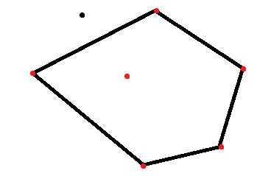
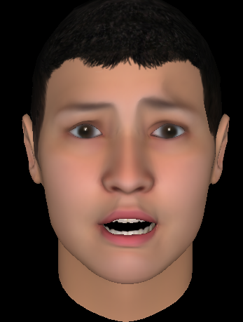
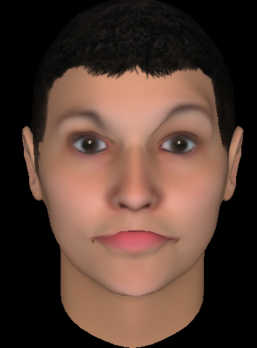
Sidebar: weights
The weights need to be large than 0 and less than 1.
W = 1
W = -1
Outlier
Inlier, 0<wi <1

Slide 14
Data representation
Mocap Data
Where is the 0th frame captured from Vicon, which contains NM vertices. Usually we use the 0th frame as a reference. Each is a 3 dimensional position vector.
Blend shape generation
Capturing the actor’s performance
Compute the boundary of convex set
Obtain through sparse sampling on facial model

Slide 15
Reconstruction Error Minimization
We aim to minimize the reconstructed error with blend shape and weights. Because head moves in the capture process, it’s necessary to remove the movement (rotation) and (translation). And
operator remove rotation and translation from j^{th} frame [10] .

Slide 16
Numerics
We hope to optimize both weights and blend shapes. The optimized blend shapes should not be far away from initial value.
is the initial value for i^{th} blend shape , is lagrangian multipliers .

Slide 17
Demo

Slide 18
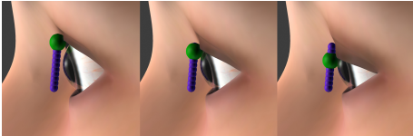
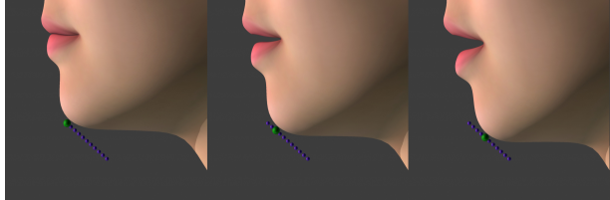
Pros and Cons
This method is very easy to implement and can generate visually good facial animation.
However, the linear blend model can’t generate very natural animation (following some curve) and for some asymmetric expression, it can’t handle very well.

Slide 19
Interested Topics
Data Driven | Linear Blend shape | Non-Linear Blend shape | Temporal-spatial analysis | Interface design
Mesh Deformation | FFD | 3D Morphing | Expression Cloning | Deformation Gradient
Physical modelling | Spring-Mass | Vector Muscle | Vibration model | Skin fabrication

Slide 20
Nonlinear Blend shape
In order to generate more natural animation, we could use nonlinear blend shapes, experiments show cubic polynomial model would be a good choice[11].
Where is actually linear blend shape .
and have equal dimension with

Slide 21
Numerics
We need to optimize both nonlinear blend shapes and weights, the initial values of and are 0.

Slide 22
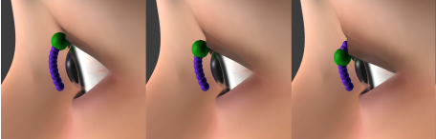
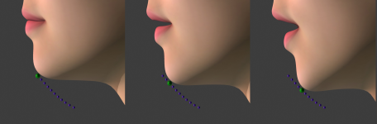
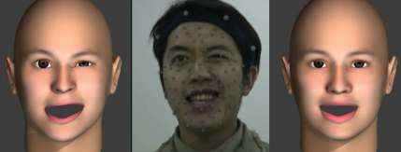
Demo

Slide 23
Pros and Cons
This method could achieve more natural expression and smaller reconstruction error.
But because the optimization is a nonlinear problem, it’s more time consuming.

Slide 24
Interested Topics
Data Driven | Linear Blend shape | Non-Linear Blend shape | Temporal-spatial analysis | Interface design
Mesh Deformation | FFD | 3D Morphing | Expression Cloning | Deformation Gradient
Physical modelling | Spring-Mass | Vector Muscle | Vibration model | Skin fabrication

Slide 25
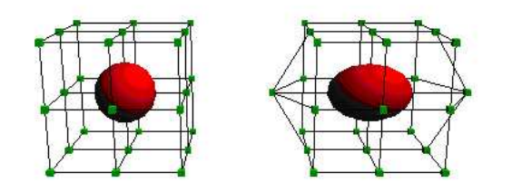
Free Form Deformation
Free-Form deformation (FFD) is a technique for manipulating any shape in a free-form manner.
To compute deformation with FFD, we need to
Generate surrounding grid for object
Compute the homogeneous coordinates using Bernstein polynomial equation
At last, the x,y,z surfaces are mapped to a Bezier surface.

Slide 26
Pros and Cons
This method is easy to implement and running very fast.
But the deformation control is not intuitive, we can’t obtain much details we expected.

Slide 27
Interested Topics
Data Driven | Linear Blend shape | Non-Linear Blend shape | Temporal-spatial analysis | Interface design
Mesh Deformation | FFD | 3D Morphing | Expression Cloning | Deformation Gradient
Physical modelling | Spring-Mass | Vector Muscle | Vibration model | Skin fabrication

Slide 28
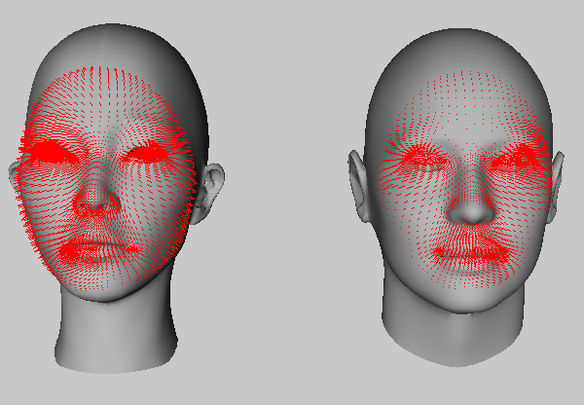
Expression Cloning
Transfer vertex motion vectors from a source face model to a target model [8]
1. Determine surface points Correspondence
2. Transfer motion vectors

Slide 29
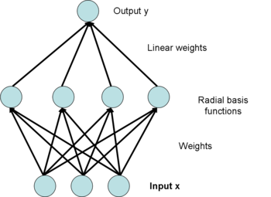
Dense surface correspondences
Radial Basis Functions (RBF)
Roughly project vertices in the source model onto the target model.

Slide 30
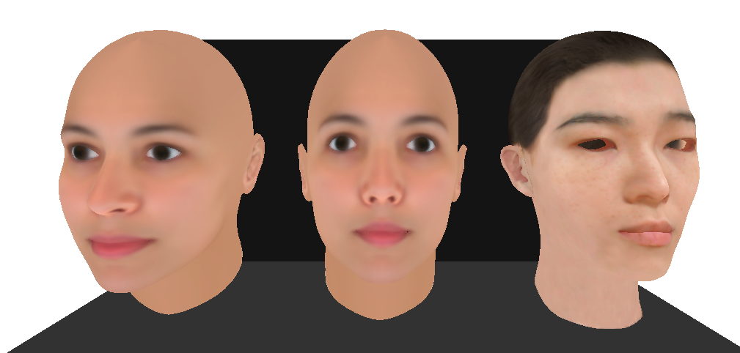
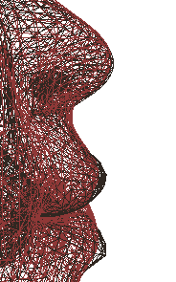
Dense surface correspondences

Slide 31
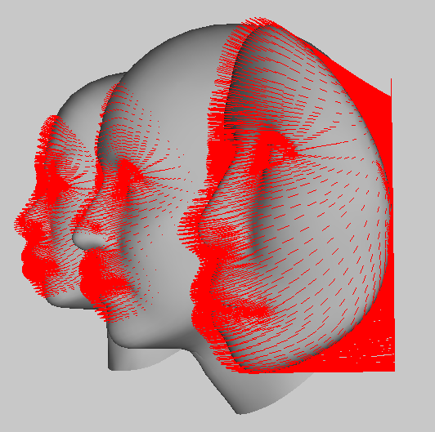
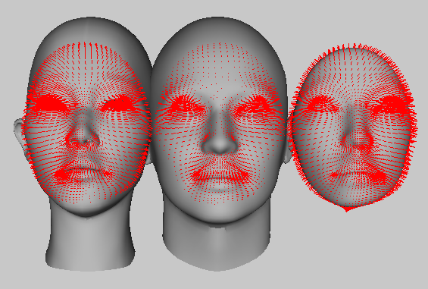
Dense surface correspondences
Cylindrical Projections

Slide 32
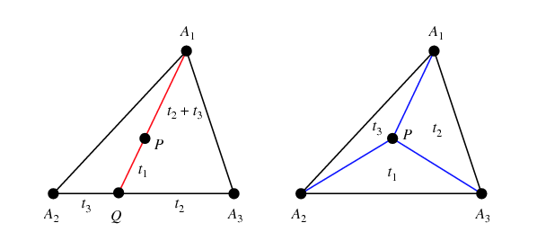
Transfer motion vectors
Barycentric coordinates

Slide 33
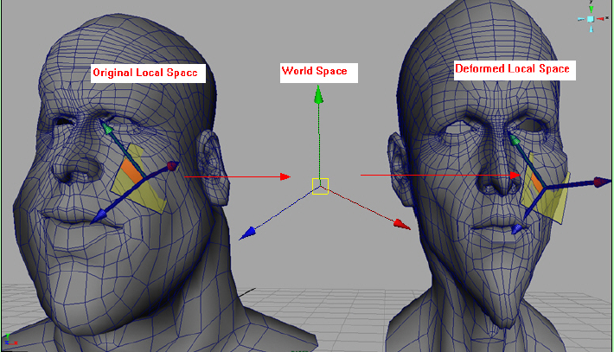
Transfer motion vectors
Direction Adjustment
is the rotation matrix between original local space and world space
is the rotation matrix between world space and deformed local space

Slide 34
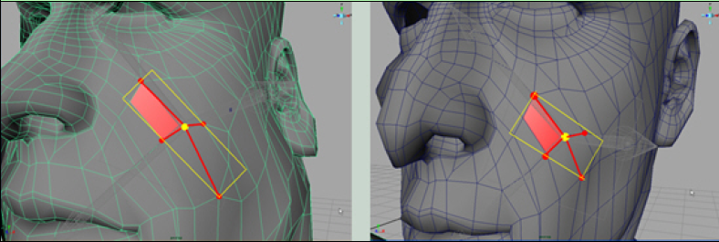
Transfer motion vectors
Magnitude Adjustment

Slide 35
Expression Cloning
Assume the motion vector of vertex on source model is , the motion vector of vertex on deformed model is

Slide 36
Pros and Cons
This method is intuitive and easy to implement.
But the method is not graceful in formulation.

Slide 37
Interested Topics
Data Driven | Linear Blend shape | Non-Linear Blend shape | Temporal-spatial analysis | Interface design
Mesh Deformation | FFD | 3D Morphing | Expression Cloning | Deformation Gradient
Physical modelling | Spring-Mass | Vector Muscle | Vibration model | Skin fabrication

Slide 38
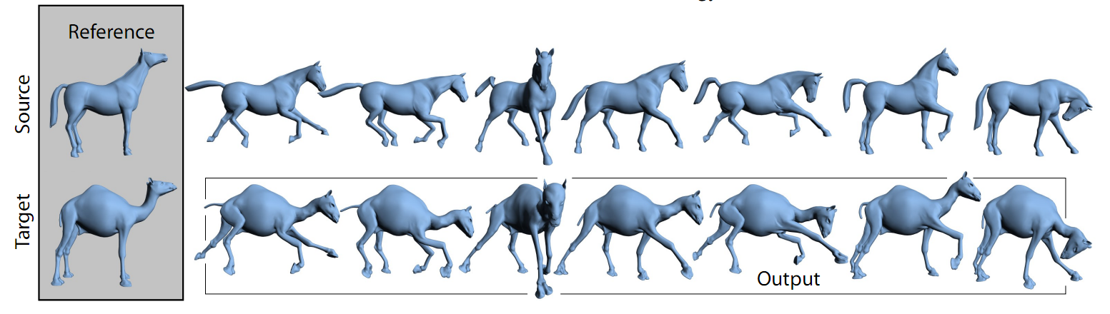
Deformation Transfer
Transfer transformations from source polygons to target polygons [9]

Slide 39
Deformation Gradient
is vertex of original triangle and is vertex of deformed triangle
v4
v3
Q + d
v1
Original
v2
Deformed
?

Slide 40
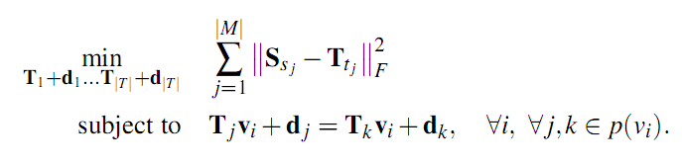
Deformation Transfer
After build correspondence between original and deformed model, we need to minimize the difference between non-translational components of the source and target deformations. Here are deformation gradients like Q we just mentioned. is a correspondence of face.
The constraint is added to keep mesh from broken. Is all neighbor faces of

Slide 41
Deformation Transfer
Keep close to Identity
Correspondence
are several vertex correspondence assigned
manually
Closest valid points
Smoothness

Slide 42
Limitations
Perhaps the most conspicuous limitation of our technique is the requirement of gross similarity between the source and target meshes.

Slide 43
Interested Topics
Data Driven | Linear Blend shape | Non-Linear Blend shape | Temporal-spatial analysis | Interface design
Mesh Deformation | FFD | 3D Morphing | Expression Cloning | Deformation Gradient
Physical modelling | Spring-Mass | Vector Muscle | Vibration model | Skin fabrication

Slide 44
Physical based Skin modeling
Based on FACS system, Platt et. Al propose a spring mesh system to simulate bone, muscle fiber and skin. Forces are applied to elastic meshes through muscle arcs generate various facial expressions. [6]
Waters proposed a vector muscle model with delineated deformation ﬁeld which models the action of muscles upon skin. A muscle deﬁnition includes the vector ﬁeld direction, an origin, and an insertion point . The ﬁeld extent is deﬁned by cosine functions and fall oﬀ factors that produce a cone shape when visualized as a height ﬁeld. Waters animates human emotions such as anger, fear, surprise, disgust, joy, and happiness using vector based linear muscles utilizing the FACS. [1]

Slide 45
Interested Topics
Data Driven | Linear Blend shape | Non-Linear Blend shape | Temporal-spatial analysis | Interface design
Mesh Deformation | FFD | 3D Morphing | Expression Cloning | Deformation Gradient
Physical modelling | Spring-Mass | Vector Muscle | Vibration model | Skin fabrication

Slide 46
Dynamic Response Textures [12]
The linear elastodynamic equation for a finite element model,
describes the displacements of N nodes within a volume.
The displacement field u is expanded in a modal displacement basis
where denotes the model's modal matrix, whose i^{th} column represents the i^{th} model shape, are the corresponding modal amplitudes. Combine the two formulations we get

Slide 47
Dynamic Response Textures
If we make the common assumption of proportional (Rayleigh) damping, then the system of ODEs are completely decoupled by the modal transformation
The system of decoupled ordinary differential equations may be written as
where the undamped natural frequency of vibration and and the dimensionless modal damping factor are

Slide 48
Pros and Cons
This method can be used to simulate geometrically complex, volumetric, physically-based, dynamic deformation models with negligible main CPU costs by exploiting commodity graphics hardware.
It’s a generalized method, for facial animation application we need to carefully adjusting parameters.

Slide 49
Interested Topics
Data Driven | Linear Blend shape | Non-Linear Blend shape | Temporal-spatial analysis | Interface design
Mesh Deformation | FFD | 3D Morphing | Expression Cloning | Deformation Gradient
Physical modelling | Spring-Mass | Vector Muscle | Vibration model | Skin fabrication

Slide 50
Physical Face Cloning [13]
Let X and x denote smooth functions describing the position of the skin in its undeformed and deformed state, respectively.
The deformation of the skin at each point can be characterized by the deformation gradient F
We denote the corresponding energy density function by

Slide 51
Physical Face Cloning
The strain energy density of the compressible neo-Hookean material is given as
where and , are shear and bulk moduli, which are related to the familiar Young’s modulus E and Poisson’s ratio as

Slide 52
Physical Face Cloning
We discretize in space using tetrahedral ﬁnite elements. The superscript e is used to identify quantities pertaining to a given tetrahedral element.
For example, let and denote position vectors for a given element in its undeformed and deformed state, respectively.
Where Na are piece-wise linear basis functions associated with the nodes of the mesh.

Slide 53
Physical Face Cloning
the discrete elastic energy of a deformed element can be expressed as
where is the element’s parameter domain and its undeformed volume.
The deformed conﬁguration of the skin is then determined as the minimum of the total energy

Slide 54
Pros and Cons
This method combines mesh deformation and physical model and novel optimization scheme that determines the shape of the synthetic skin as well as the actuation parameters that provide the best match to the target expressions.
It’s more time consuming.

Slide 55
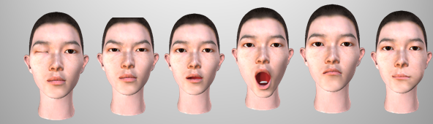
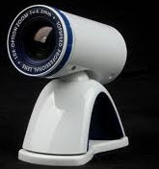
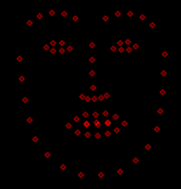
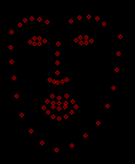
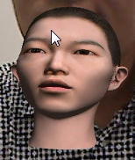
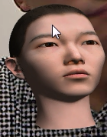
Performance driven facial animation
To supply a simple and intuitive controlling method in making facial animation.
Facial feature localization
Gaze estimation
Motion parameterization
expressions
Feature localization
Head motion

Slide 56
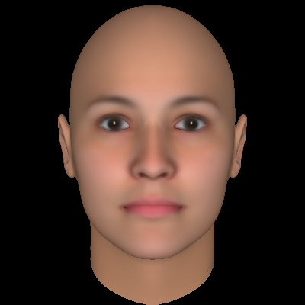
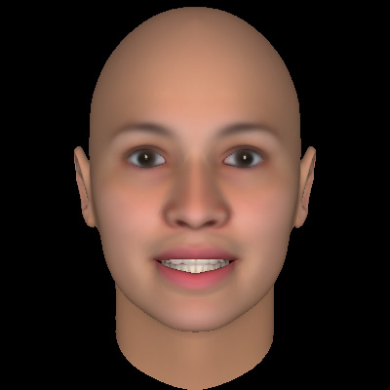
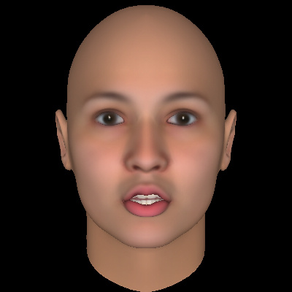
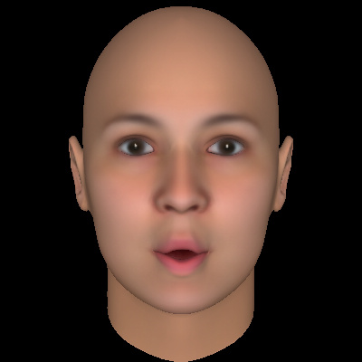
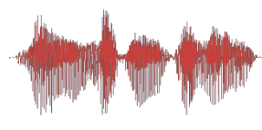
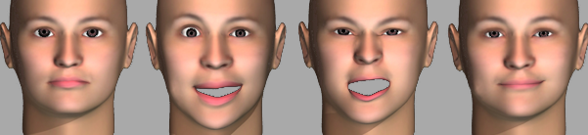
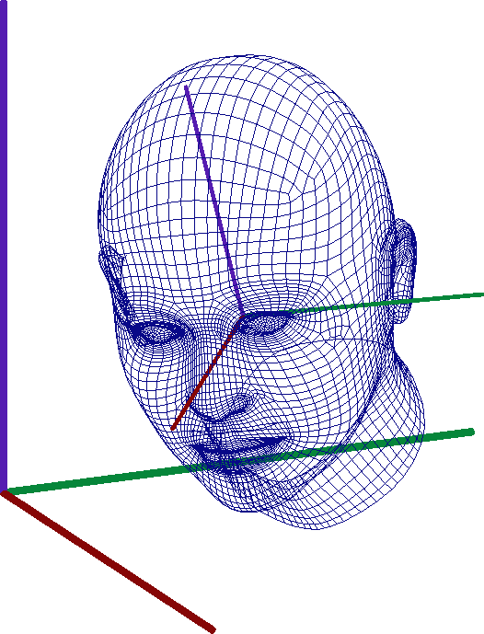
Speech driven facial animation
Visual speech animation can be regarded as visual motions of the face (especially the mouth part) when humans are speaking.
Lip motion
Viseme or Data
drive
expression
Head motion

Slide 57
Resources in Facial animation
Software and Device :
Facegen, could generate a large variety of model and blend shapes
Faceworx, vertices texture map generation and modelling
Poser, DIY blend shapes
3ds Max, model editing and animation rendering (vertex plugin)
Maya, blend shape plugin
FaceRobot, facial rigging and animation
Vicon IQ, Blade motion capture and editing
Vicon , high frame rate optical marker tracker
Structured light, high precision model generation
3D scanner, high precision model generation

Slide 58
References
[1] Z. Deng and J. Noh. Computer Facial Animation: A Survey. DATA-DRIVEN 3D FACIAL ANIMATION 2007, 1-28, DOI: 10.1007/978-1-84628-907-1_1
[2] F. Parke. Computer generated animation of faces. In Proc. ACM Nat’l Conf., volume 1, pages 451–457, 1972.
[3] F.I. Parke and K. Waters. Computer Facial Animation. 1996.
[4] P. Ekman and W.V. Friesen. Facial Action Coding System. Consulting Psychologists Press, 1978.
[5] K. Waters. A muscle model for animating three-dimensional facial expression.
In SIGGRAPH Proceedings, volume 21, pages 17–24, 1987.
[6] S. Platt and N. Badler. Animating facial expression. computer graphics. Com-
puter Graphics, 15(3):245–252, 1981.
[7] http://en.wikipedia.org/wiki/Computer_facial_animation

Slide 59
References
[8] J. Y. Noh and U. Neumann. Expression cloning. Proc. of ACM SIGGRAPH’01,
pages 277–288, 2001.
[9] R. W. Sumner and J. Popovi´c. Deformation transfer for triangle meshes. ACM
Trans. Graph., 23(3):399–405, 2004.
[10] X. Liu T. Mao S. Xia Y. Yong Z.Wang. Facial animation by optimized blendshapes from motion capture data. Computer Animation and Virtual Worlds 2008. Volume 19 Issue 3-4, September 2008 pp 235-245
[11] X. Liu S. Xia Y. Fan Z.Wang. Exploring non-linear relationship of blendshape facial animation. Computer Graphics Forum, doi: 10.1111/j.1467-8659.2011.01852.x, 2011
[12] D.L. James, D.K. Pai. DyRT: dynamic response textures for real time deformation simulation with graphics hardware. ACM Transactions on Graphics (TOG) - Proceedings of ACM SIGGRAPH 2002. Volume 21 Issue 3, July 2002 pp 582 - 585
[13] B. Bickel, P. Kaufmann, M. Skouras, B. Thomaszewski, D. Bradley, T. Beeler, P. Jackson, S. Marschner, W. Matusik, M. Gross. Physical Face Cloning. ACM Transactions on Graphics (Proc. SIGGRAPH 2012), vol. 31, no. 3, August 2012.

Slide 60
References
[14] T. BEELER, F. HAHN, D. BRADLEY, B. BICKEL, P. BEARDSLEY, C. GOTSMAN, R. W. SUMNER, M. GROSS. High-Quality Passive Facial Performance Capture Using Anchor Frames. ACM Transactions on Graphics (Proceedings of SIGGRAPH). 2011. (Vancouver, Canada).
[15] Hao Li, Bart Adams, Leonidas J. Guibas, Mark Pauly . ROBUST SINGLE-VIEW GEOMETRY AND MOTION RECONSTRUCTION. ACM Transactions on Graphics, Proceedings of the 2nd ACM SIGGRAPH Conference and Exhibition in Asia 2009, 12/2009
[16] Craig Donner and Henrik Wann Jensen. A Spectral BSSRDF for Shading Human Skin. EGSR 2006
[17] Iman Sadeghi, Heather Pritchett, Henrik Wann Jensen, Rasmus Tamstorf. An Artist Friendly Hair Shading System. ACM Transactions on Graphics 29(4), SIGGRAPH 2010.
[18] Manfred Lau, Ying-Qing Xu and Harry Shum. Interactive Manipulation of 3D Facial Expressions Using Facial Priors . ACM Transactions on Graphics (Presented at SIGGRAPH 2010), 29(1): Article No. 3.
[19] Jing Xiao and Jessica Hodgins. Vision-based Control of 3D Facial Animation. ACM SIGGRAPH/Eurographics Symposium on Computer Animation 2003.

Slide 61
Thank you Questions are appreciated.

